Slide 1
Lesson 33: “Ye Are the Temple of God”
Corinthians 1-6

Slide 2
Purpose
To inspire class members to seek the blessings that come from being unified in Christ, following the Spirit, and being morally clean.
Notes:
For Gospel Doctrine Manual

Slide 3
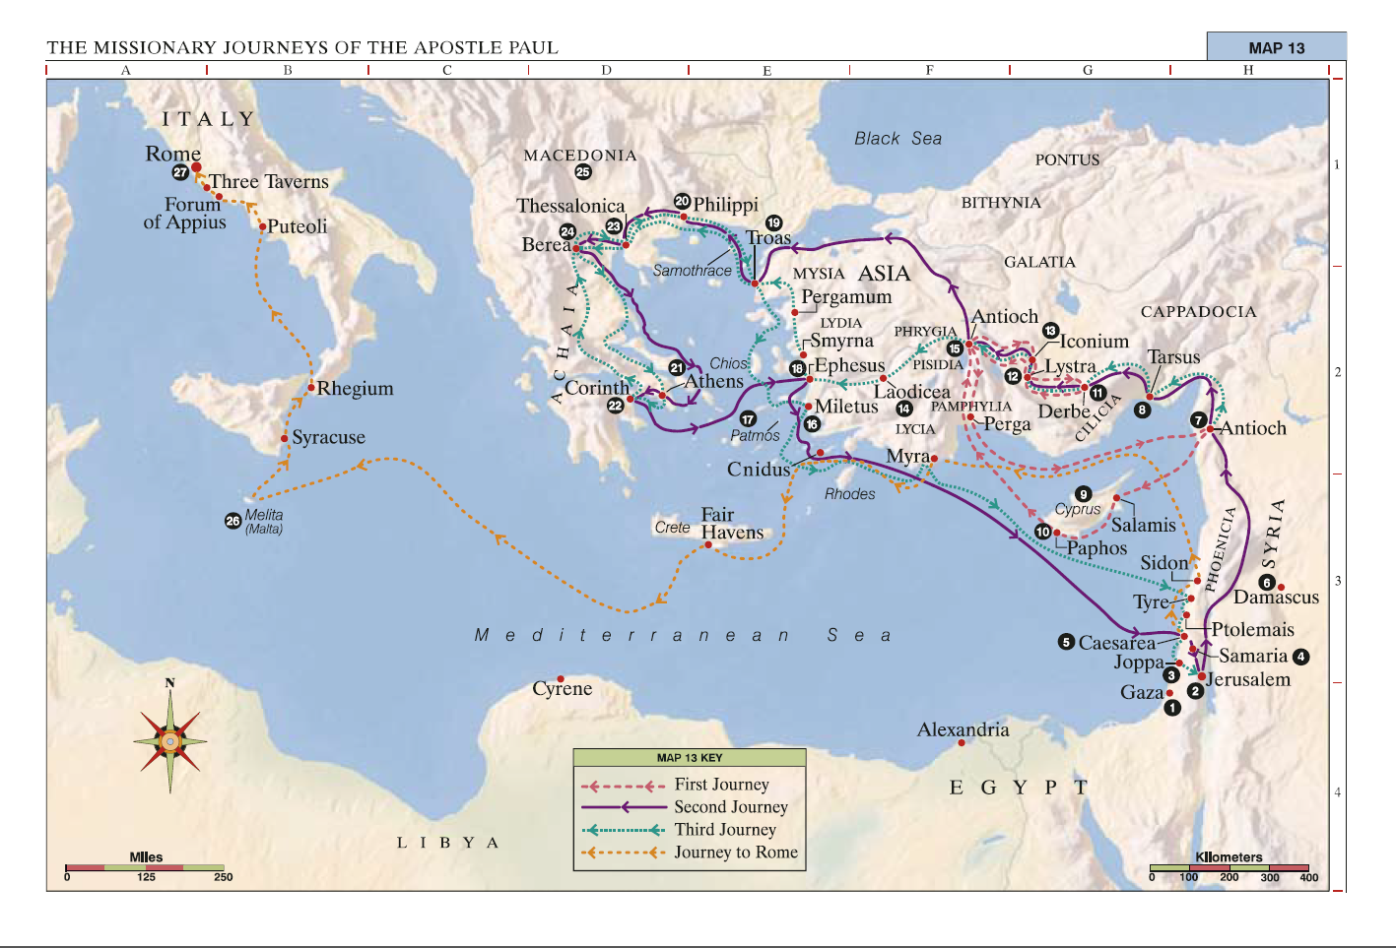
Where is Corinth?
Notes:
Jerusalem to Corinth ~= San Antonio, TX to Atlanta Georgia or SATX to Disneyland

Slide 4
Timeline of Paul and Corinth
Paul and Barnabus take second missionary journey (Acts 15:36)
Paul has a vision to go to Macedonia (Acts 16:9-10)
First visit to Corinth lasting 18 months (c. AD 51) (Acts 18:3,9-11)
Goes to Jerusalem, then takes third missionary journey to Ephesus to begin a three-year stay (c. AD 53–55) (Acts 18-19)
Writes the “previous letter” [Corinthians A] (c. AD 53–54) (1 Cor. 5:9)
Hears of reports from the Corinthians (1 Cor. 1)
Writes “1 Corinthians” [Corinthians B] (c. AD 54–55)
Notes:
If time Permits, mention Paul stayed in Corinth for two reasons- Financially, he had a paying Job there, and God told him to.

Slide 5
The report from Corinth
Chapters 1-6
There is division. People in the church were associating with various leaders and making factions that were tearing down the body of Christ.
The Saints are following the secular order and not the order of the church.
There is immorality
Setting a bad example
Questions about Marriage.
Questioning of Paul’s Authority.
More Division, lack of kindness.

Slide 6
Division
1 Corinthians 1:10-13
Notes:
Cor. 1:10-13- Known someone who was a follower of X and fell away at changing of the guard? President Hinckley? North Stake/High Country? Bishop so-and-so? Teacher X? YM/YW Program?

Slide 7
Division
1 Corinthians 1:10-13
Vs 10 KJV- Now I beseech you, brethren, by the name of our Lord Jesus Christ, that ye all speak the same thing, and that there be no divisions among you; but that ye be perfectly joined together in the same mind and in the same judgment.
Vs 10 NET- I urge you, brothers and sisters, by the name of our Lord Jesus Christ, to agree together, to end your divisions, and to be united by the same mind and purpose.
Notes:
Thinking of the Godhead, how are these three things needed today?

Slide 8
Divisions in the Church (1:10–4:21)
The Fact of Divisions
The Causes of Division
Faulty View of the Christian Message
  False Wisdom Vs. the Gospel of Christ
    The Foolishness of the Cross to Gentiles (1:18-19)
    Wisdom knew not God (1:21)
    The Centrality of the Cross to Paul’s Preaching (2:1-2, 3:1-2)
  True Wisdom and the Spirit of God
    The Learning of the Spiritual Man (2:6,7,10)
    The Learning of the Carnal Man (3:1-2)
Faulty View of Christian Ministry and Ministers
  Analogy One: Farmers and the Field (3:6-9)
  Analogy Two: Builders and the Temple (3:10-11)
    The Builders (3:14-15)
    The Temple (3:16-17)
  Warning about Self-Deception regarding the Ministers (3:18)
  Paul’s Reflections on his own Ministry (4:3-4)
Faulty View of the Christian’s Blessings (4:7, 9-13)
The Cure for Divisions (Rest of the Letter)
  Follow Paul’s Teachings, Learn from Timothy (4:16-17)
Notes:
Cor. 1:18-19- Why is the cross foolishness to the logical mind?
Cor 1:21 Why can’t the wisdom of the world find out God?
Cor. 2-1-2, 3:1-2- Remember that last bit, need it later. Why Milk before Meat? Why only Christ and him Crucified? Why only Christ in America, JS a prophet, and Pray and Ask God if it is true?
Cor. 2:6,7,10 – Is it okay to go deep? Yes! Has any one had a spiritual prompting that they didn’t really fully understand? Atonement revelation.
3:6-9 Ministers success is really God’s success. 6 positive contacts before interest
3:10-11- Foundation is Christ
3:14-15- Builders are the Ministers
3:16-17- We are what is being built up. We are the edifice to God’s Glory.
Cor 3:18- As a minister (We are all ministers) why is it important to not be “self-deceived” and stay humble? Paul’s answer in 4:3-4, Do you ever perform at church for others?
In response to being “puffed up” 4:7- We’ve earned nothing. Avg. Salary in Cebu is ~$100 US Dollars a month. (9-13) Apostles (ones sent forth) live simple lives

Slide 9
Immorality (5:1–6:20)
Failure to Discipline an Immoral Brother (5:1-13)
Failure to Exercise Sexual Purity and Other Moral Behavior (6:12-21)
Well-Known Corinthian Problem
  Sea Port
  Slang of the age: Corinthianize
Notes:
Excommunicate people who sleep with their Father’s Wife. Fornicate = Corinthianize.

Slide 10
Sexual Immorality
Why are sexual sins so serious?
What are the blessings of being morally clean?
Notes:
From the Manual

Slide 11
Remember
1 Cor. 6:9-11- Know ye not that the unrighteous shall not inherit the kingdom of God? …And such were some of you: but ye are washed, but ye are sanctified, but ye are justified in the name of the Lord Jesus, and by the Spirit of our God.
D&C 58:42
Notes:
From the Manual- Don’t let the sin get you down, Charlie Brown.

Slide 12
1 Corinthians 6:18–20
Why do you think this is an appropriate comparison?
What things can defile our bodies?
What should we do to treat our bodies as temples?
Notes:
End back on Ye are Temples of God.

