Slide 1
Missionary Work
Gospel Principles Lesson #33
Notes:
The pointless cover slide

Slide 2
Switch: How to Change Things when Change is Hard
Direct the Logical Mind (the “rider”)
Find bright spots
Script critical moves
Point to the destination
Motivate the Emotional Mind (the “elephant”)
Find the feeling
Shrink the change
Grow your people
Shape the Path
Tweak the environment
Build Habits
Rally the Herd
Notes:
A reminder of the theme covered a few weeks ago of the Elephant and the Rider, and noting today I’ve tweaked the environment by removing extra chairs.

Slide 3
What is missionary work?
Work we do to fulfill the mission of the Church.
Notes:
The most all-encompassing definition.

Slide 4
What is the mission of the Church?
The Church of Jesus Christ of Latter-day Saints was organized by God to assist in His work to bring to pass the salvation and exaltation of His children. The Church invites all to “come unto Christ, and be perfected in him” …In fulfilling its purpose to help individuals and families qualify for exaltation, the Church focuses on divinely appointed responsibilities. These include helping members live the gospel of Jesus Christ, gathering Israel through missionary work, caring for the poor and needy, and enabling the salvation of the dead by building temples and performing vicarious ordinances
Handbook 2 “The Purpose of the Church”
Notes:
4 fold mission of the church

Slide 5
How do we do missionary work?
We can show friends and others the joy we experience from living the truths of the gospel.
We can overcome our natural shyness by being friendly to others and doing kind things for them. We can help them see that we are sincerely interested in them and are not seeking personal gain.
We can explain the gospel to nonmember friends and others.
We can invite friends who are interested in learning more about the gospel to be taught by the missionaries.
We can teach our children the importance of sharing the gospel.
We can pay our tithing and contribute to the missionary fund.
We can invite nonmembers to activities such as family home evenings and Church socials, conferences, and meetings.
We can give copies of Church magazines. We can also share gospel messages by using features available on the Church’s official Internet sites
Notes:
Straight from the Gospel Principles Manual

Slide 6
Member-Missionary Work Made Easy
Be Friendly
Be Mormon
Have an open home
Have a “Mormon Home”
Have the missionaries over
Invite people to participate, no pressure, no preaching
Notes:
From a recent local fireside. If you are nice and people know you are LDS, your faith is going to come up.

Slide 7
Lots of Exposure/Opportunity
Book of Mormon Musical nominated for 14 Tony Awards
Glenn Beck
Harry Reid
Mitt Romney
Jon Huntsman
Marie Osmond
“After initially rebuffing the efforts of two Mormon missionaries she met outside a friend’s apartment door, McElroy had a change of heart after seeing a “South Park” satire of the religion.”
http://www.dailytarheel.com/index.php/article/2011/04/chapel_hill_mormon_community_grows_larger
Notes:
Yes there is a lot of challenges, but there is a silver lining. May discuss real church in Uganda.

Slide 8
Gary Lawrence Survey Data
84% exposed to lit., video, or missionaries
Only 14% aware of concept of restoration
Only 29% aware of concept even aided
67% aren’t sure we believe the bible
77% aren’t sure we aren’t Christians
85% aren’t sure we aren’t polygamists
37% don’t know a Mormon
55% don’t know an active Mormon
Notes:
Most non-LDS are ignorant. Raising awareness needs to be a primary objective. We do this by being less insular and more open.

Slide 9
More Gary Lawrence, 6 steps
Awareness (40%) just that we exist
Awakening (25%) that mormons are part of society
Curiosity (11%) – ask
Interest (9%)- listen
Investigation (5%)- read
Conversion (1.7%)
Notes:
We need to recognize what level people are at. Not everyone is ready for missionary discussions. My wife heard once that on average a person has seven positive contacts with members before they join the church. 1 Negative contact can wipe them out though.

Slide 10
Survey of 200 Active LDS Converts
Notes:
Converts come in all ages, 10-59. Yes some age groups have more converts, but this doesn’t mean other age groups don’t also have converts. There are 200,000 converts a year. Follow the spirit, not the stats.

Slide 11
Gordon B. Hinckley
I am hopeful that a great effort will go forward throughout the Church, throughout the world, to retain every convert who comes into the Church. This is serious business. There is no point in doing missionary work unless we hold on to the fruits of that effort. The two must be inseparable.
Notes:
Retention is part of missionary work

Slide 12
13th Article of Faith
Nelson Searcy, Pastor at “The Journey Church” on New Member Integration
“Fusion: Turning First Time Guests into Fully-Engaged Members of Your Church”
Notes:
We can look to other faiths for Guidance.

Slide 13
3 “R”s of Retention
Return- decide to come again after the first impression
Relationship- make friends with other church members
Responsibility- take ownership in the mission of the church
Sound Familiar? Missing Something?
Notes:
Searcy says the first visit should be focused on getting them to have a second visit. Then focus on making friends, and finally on having a responsibility related to church.

Slide 14
Gordon B. Hinckley
Someone has failed, failed miserably. I say to bishops throughout the world that with all you have to do — and we recognize that it is much — you cannot disregard the converts. Most of them do not need very much. As I have said before, they need a friend. They need something to do, a responsibility. They need nurturing with the good word of God. They come into the Church with enthusiasm for what they have found. We must immediately build on that enthusiasm
Notes:
Friend, responsibility, nurturing

Slide 15
A Friend
In another Christian denomination, a survey of churches with successful retention rates cited the main reason for success in this area to be positive relationships between members. They note that “the development of these relationships with new members best takes place before the member joins.”
A person involved in a Sunday school class (Small Social Church Group) is five times more likely to be active in the church five years later, than a person who attends worship services alone
Notes:
Genuine member referrals are important because of the support system. Non-Sacrament meeting Church is important.

Slide 16
A Responsibility
The Church is a Volunteer Organization
Volunteers want to help, it is essential that you do everything you can to give them work to do as soon as possible. Underutilization or Incorrect Utilization creates serious retention problems, because motivated members who are trying to be of assistance will feel useless if they are not actually involved in doing something. They will also lose any sense of relationship with the organization over long periods of non-involvement.
Engagement is important at church, engaged members are exponentially (10x) more likely to be retained members.
Notes:
Engagement Survey

Slide 17
One Interesting Survey recently asked what things were most important to volunteers in general.
Rank | Item
1 | Helping others
2 | Clearly defined responsibilities
3 | Interesting work
4 | Competence of supervisor
5 | Supervisor guidance
Notes:
Every Member supervises somebody.

Slide 18
Nurturing with the good word of God
Encourage in every way possible more spiritual Church meetings, especially sacrament meetings. One of the great fears missionaries have at least in some locations is taking their investigators to church…It will also help orient investigators if missionaries will take some time to explain the ordinance of the sacrament that investigators will be witnessing, what it means for the renewing of baptismal covenants, that the emblems represent the Savior’s body and blood, and so forth.
-Jeffrey R. Holland
Notes:
Holland talk from when I was in the MTC

Slide 19
More from Elder Holland
Do all that you can to make your baptismal services a spiritual, Christ-centered experience. A new convert deserves to have this be a sacred, carefully planned, and spiritually uplifting moment. The prayers, the hymns, surely the talks that are given—all ought to be focused on the significance of this ordinance and the Atonement of Christ…Probably no other meeting we hold in the Church has the high referral and future baptismal harvest that a baptismal service does…

Slide 20
Even More from Elder Holland
Throughout the teaching experience, missionaries must bear testimony of the Savior and His gift of salvation to us. Obviously you should bear testimony regularly of all the principles you are teaching, but it is especially important that you bear testimony of this central doctrine in the plan of our Heavenly Father.

Slide 21
Nurturing Fundamentals
The First Vision: There is a God, He speaks to us today, He answers prayers, He forgives sins. He loves us.
The Restoration of the Gospel: Jesus is the Christ, he is the source of our salvation. We can trust in him. We are his.
The Restoration of the Priesthood: There is a way God wants us to follow.
The Restoration of the Church: There is somewhere I can go for support, direction, and a chance to make a difference.
The Restoration of the Keys of Salvation: I have a purpose in my life, and it will help others.
The Restoration of Temple Ordinances: The relations I have in life will extend into the eternities.
-6 Events, Stephen R. Covey
Notes:
Focusing on the fundamentals makes the Gospel more Nutritional. Avoid craziness.

Slide 22
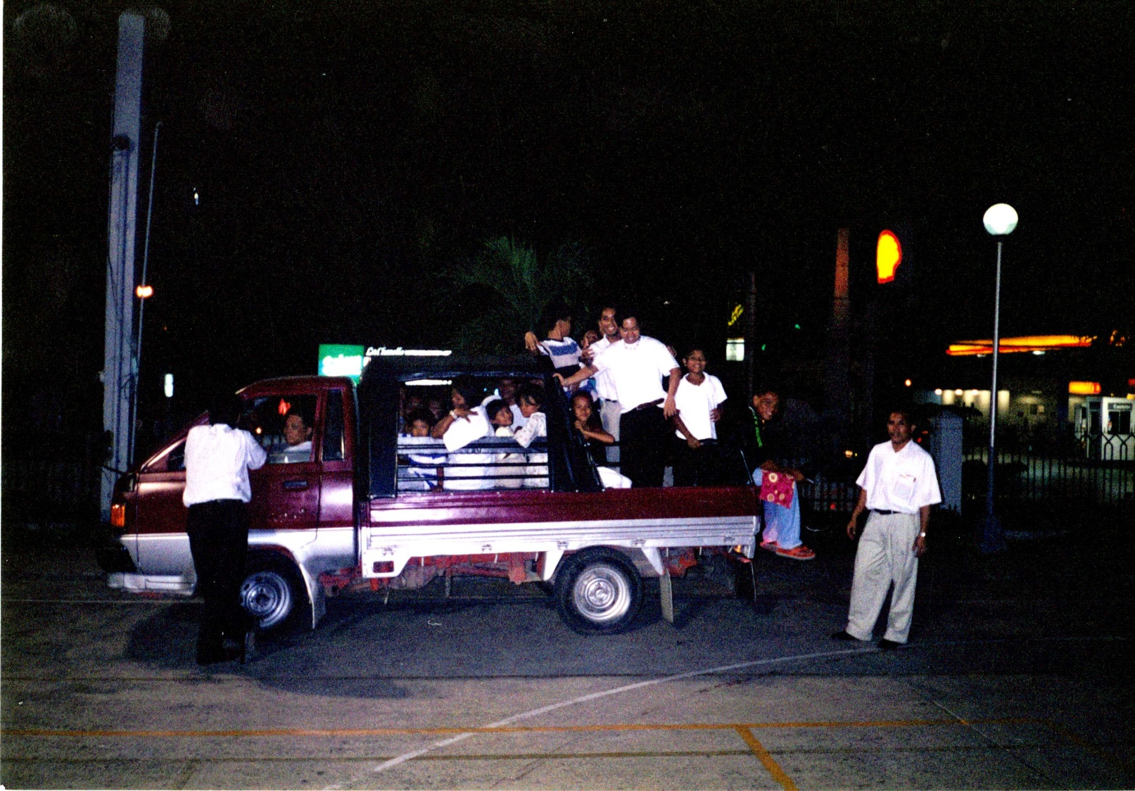
Mission to Philippines
Notes:
Crazy Referral led to 30+ Baptisms.

Slide 23
Mission to Philippines
Notes:
This guy drove them all to church. Never came inside. Finally baptized because I said he could wear shorts to church. We need to remove cultural ethnocentricity so we can reach more people. Divorced people. Women in Pants. Democrats. Oh My! These people can have a home in the fundamentals of the Gospel.

Slide 24
6 Simple Suggestions from Nelson Searcy
Start writing and mailing hand-written follow-up notes to your first time visitors, thanking them for attending.
Have a Communication Card that is simple and to the point to get contact information from guests.
Put up signs to direct people toward bathrooms, children’s areas, etc.
Take a hard look at your building- improve the landscaping, pick up clutter, paint a sign, improve lighting, etc.
Start offering generous enticing refreshments
Place smiling friendly greeters at the outside doors to church
Notes:
Returning to the Evangelical, if there is time. Tell of member involvement in personal conversion. End.

