Slide 1
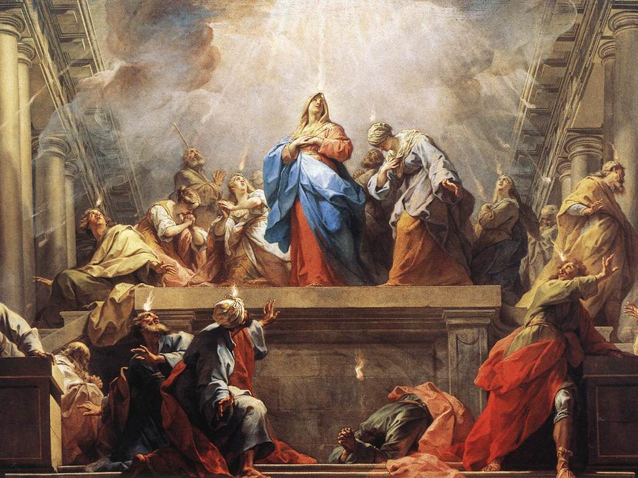
1st Century Christianity

Slide 2
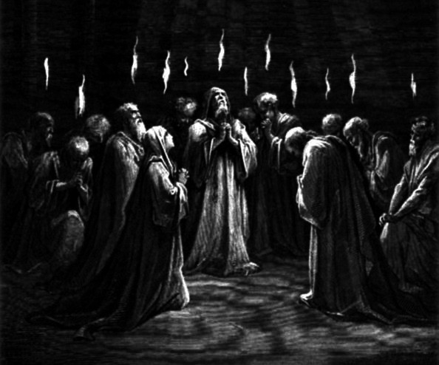
The Apostolic Age(33-100 AD)
~33 or 34-Death and Resurrection of Christ
50 days later-Day of Pentecost
40-Primarily Jewish
44-James son of Zebedee martyred
50-Council of Jerusalem
63-Extreme Persecution under Nero
66-First Jewish War
70-Temple is Destroyed- Dispersion from Jerusalem
74-Simon the Zealot, second to last apostle, martyred
81-Christians ask to not be considered Jewish to avoid Tax
85- Judaism declares Christians not Jewish
100-John, the last original apostle, gone
132-Second Dispersion due to Jewish revolt
367-New Testament Canon Finalized

Slide 3
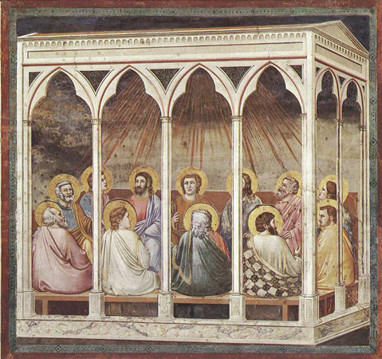
Characteristics
Revelation/Inspiration
Miracles/Acts of Faith
Authority/Priesthood
Leadership/Order
Work to save/serve others
Ordinances
Obeyed Commandments
Focus on Christ’s Atonement

Slide 4
1 Corinthians 15:3-4 Christian creed of 40 AD- 7 years after time of Christ.
Χριστὸς ἀπέθανεν ὑπὲρ τῶν ἁμαρτιῶν ἡμῶν κατὰ τὰς γραφάς
Christ died for our sins according to the scriptures
καὶ ὅτι ἐτάφη καὶ ὅτι ἐγήγερται τῇ τρίτῃ ἡμέρᾳ κατὰ τὰς γραφάς
And that he was buried, and that he rose again the third day according to the scriptures

Slide 5
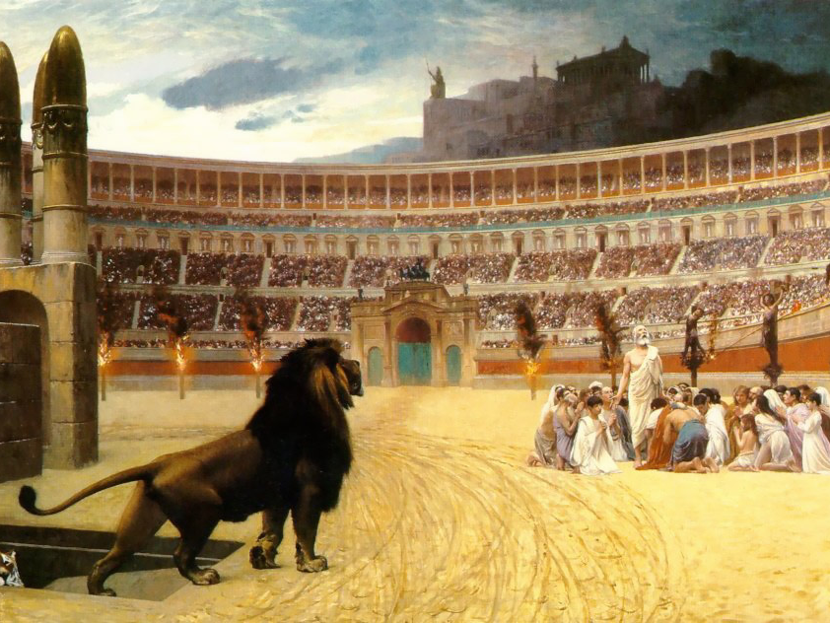
What Happened? Matthew 25:5-12
Vs.5- For many shall come in my name, saying, I am Christ; and shall deceive many.
Vs.9- Then shall they deliver you up to be afflicted, and shall kill you: and ye shall be hated of all nations for my name's sake.
Vs.10-And then shall many be offended, and shall betray one another, and shall hate one another.
Vs.11-And many false prophets shall rise, and shall deceive many.
Vs.12-And because iniquity shall abound, the love of many shall wax cold.

Slide 6
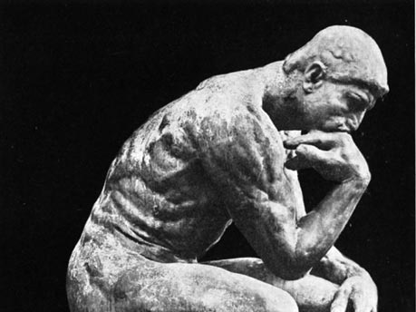
Why?
Why would God allow an apostasy to happen?
Why would God put Christ on Earth only to follow up with 1800 years of apostasy?
Why couldn’t the apostasy happen again?

